Slide 1
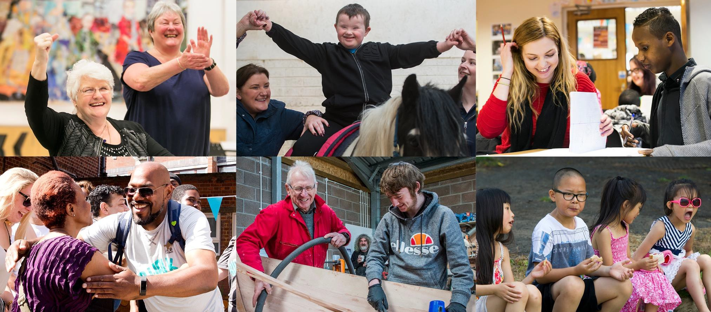
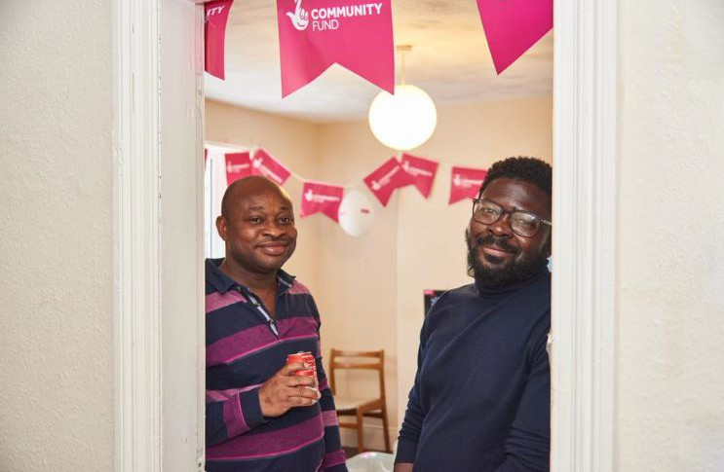
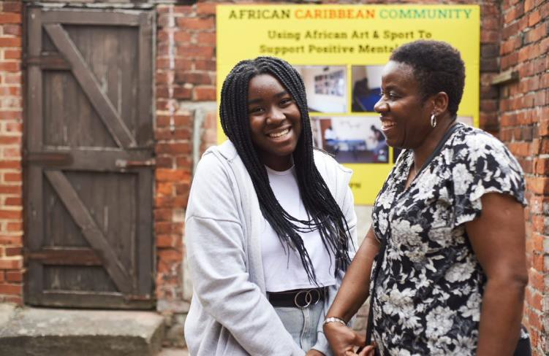
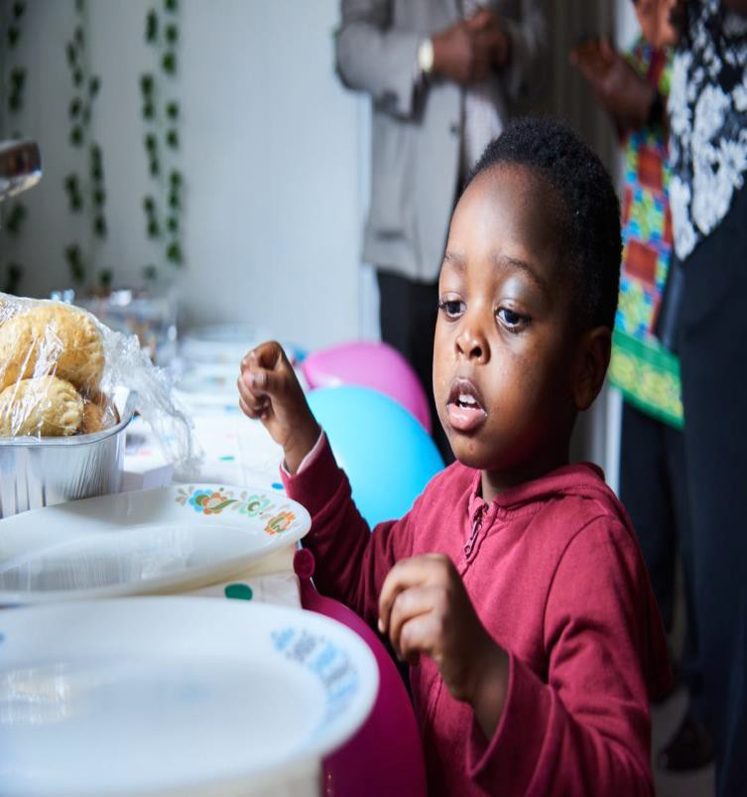
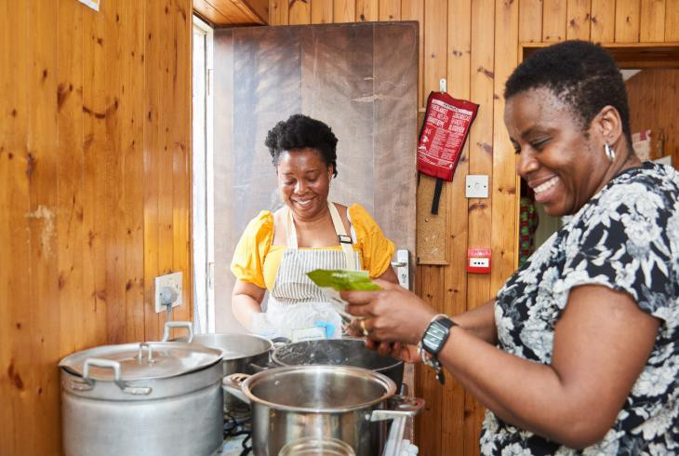
Windrush 75
Awards For All England

Slide 2
What will this session cover.....
Our funding offer for Windrush projects
Eligibility
Application process
Grant Application Clinics
Short Q&A

Slide 3
Meeting Etiquette
We want you all to get the most from these sessions and for you to fully engage with us, so we please ask the following of you.
Switch off your mobile phones!
Log out of Outlook and other applications.
Set your TEAMS to do not disturb.
Stay muted until we unmute you.
Raise your virtual hand if you have a question.
There is no need to make notes as all this information is available on our website.
Thank You!

Slide 4
Who we are
National Lottery players contribute around £30 million to good causes every week
Our income comes from the sale of National Lottery tickets. Of every £2 spent on a Lottery ticket 56p (28%) goes to good causes.
The National Lottery Community Fund distributes around £600m a year to communities across the UK
In 2021/2022 83% of our grants were under
£10,000

Slide 5
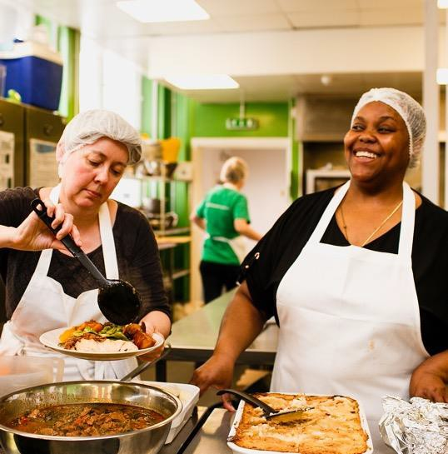
We fund
all sorts
of activity

Slide 6
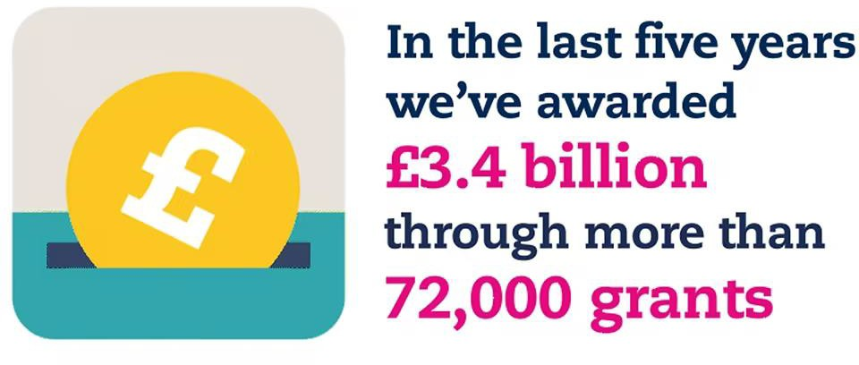

Slide 7
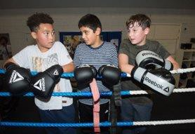
Our support for communities
Up to £10,000
National Lottery Awards for All - our most popular funding stream, providing a quick and simple way to get small Lottery grants of between £300 and £10,000
Over £10,000
We provide long-term support to single organisations through Reaching Communities, to help communities take action on the issues that matter to them
We support organisations to work together through our Partnerships funding, inspiring joint action that goes beyond what any single organisation can achieve alone

Slide 8
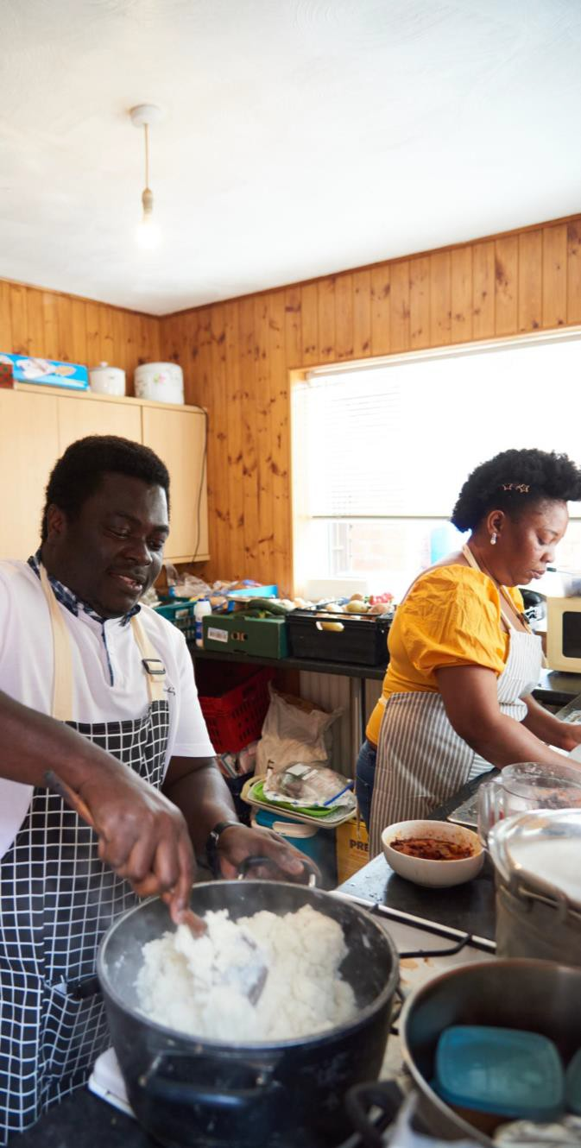
Key National Moments
We will help communities celebrate the national events that are important to them - including the 75th anniversary of Windrush, The Eurovision Song Contest and Coronation of His Majesty The King.

Slide 9
Awards for All England
Funding for smaller, grassroots community organisations to do great things
Simple to apply for £300 to £10,000 for one year
We ask you to involve your community
For Support
Our Advice Line: 0345 4 10 20 30
Our website:
Our email:
Book tickets for our clinics at:
•

Slide 10
Our Programme
We're here to support communities with the things that are important to them, including mitigating the impact of the cost-of-living crisis and supporting them as they seek to recover, rebuild and grow following the Covid-19 pandemic.
We’ll also help communities celebrate the national events that are important to them - including the 75th anniversary of Windrush, The Eurovision Song Contest and Coronation of His Majesty The King.

Slide 11
Aims
You can apply for funding to deliver a new or existing activity or to support your organisation to change and adapt to new and future challenges. In order to support communities, we fund projects and organisations which aim to:
build strong relationships in and across communities
improve the places and spaces that matter to communities
help more people to reach their potential, by supporting them at the earliest possible stage
support people, communities and organisations that are facing increased
demands and challenges as a direct result of the cost-of-living crisis.

Slide 12
Community Involvement
Your project must involve your community from the start
People understand what’s needed in their communities better than anyone,
especially during these unprecedented times. We want to support projects that:
involve people and communities from the start
build on people’s strengths
are connected in their community.
Think about what you can do to find out what's important to people in your community. For example, surveys, meetings, telephone calls, conversations with helper agencies and engaging with stakeholders.

Slide 13
Project Example
Project Summary One:
Bringing young people together with their grandparents and others in the Windrush generation to learn about the difficulties they faced and the ways they found to find happiness in their lives. The project aims to use the medium of a collaboratively produced book to bring together all these stories and build up a collective narrative.
For the participants, it hopes to bring about a better connection between generations and result in a deeper understanding of the history of the period and what it means for them. It will also hope to give the young people a purposeful direction to overcome obstacles, to believe in themselves and instil a positive attitude.

Slide 14
Project Example
Project Summary Two:
The funding will be used to run a joint Platinum Jubilee/Windrush celebration event. Several activities will be available over a three-day period including cake decorating, face painting, indoor games and sport, board games, live music, presentations, dressing up, food cookery classes, specialist food buffets, gospel choirs, guest speakers and flag raising.
Additionally, Welfare Advocates will be on site to support individuals and families with applications to the Windrush compensation scheme. The project aims to raise awareness of and support the Windrush generation and build community cohesion with a cross generational event as well as impart learning through and exhibition of photographs and videos.

Slide 15
Project Example
Project Summary Three:
The funding will be used to deliver weekly activity sessions to the older Windrush Generation. The project aims to reduce loneliness and isolation as well as improve mental wellbeing. These activities will include a guest speakers, Bingo, youth entertainment, arts and crafts, cultural traditions and games.
It will also include four quarterly outings in the year including a visit to the National Windrush Monument.

Slide 16
More support
Our online application
Our funding officers
Contacting you
Accessibility
And remember, if you are unsuccessful, there is no limit on the number of times you may apply. Awards for all England is a rolling programme with no end date.

Slide 17
Who can apply?
Smaller grassroots community organisations
We prioritise groups with smaller incomes on National Lottery Awards for All
Organisations that apply must have at least two people on their board or committee who are not connected
Bank account in legal name of organisation

Slide 18
What can we fund?
organisation's running costs
small land or refurbishment projects
equipment
one-off events
staff costs
training costs
transport
utilities
volunteer expenses
Any organisational costs needed to support a group and its community through the current crisis.

Slide 19
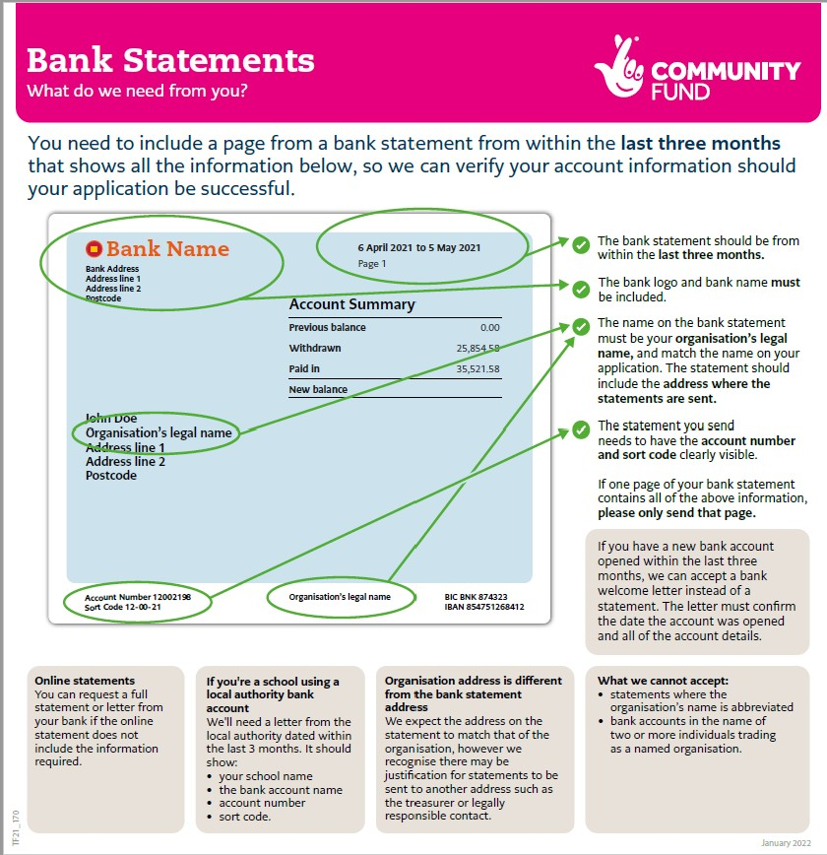

Slide 20
Is Awards for All right for your community and organisation?
Eligibility – are you eligible?
Fit with funding priorities and community-led approach
Consultation – does this matter most to your community
Correct signatories
Correct bank statement
Financial controls and governance
Clear advice on all these areas can be found on our website.

Slide 21
Apply
Apply online - go to our website – read the guidance on eligibility and apply using the online webform
Accessibility - If you cannot apply online, you can contact the Advice Team for alternative ways to apply.
You will receive an automated email detailing the information you have
supplied - senior contact will automatically receive a copy.
We expect to get a decision to you within 12 weeks of applying –
please apply at least 12 weeks BEFORE you need the money.
Need help? Attend one of our Grant Application Clinics for further pre- application support. Or call our Advice line on 0345 410 20 30.

Slide 22
Grant Application Clinics
To support you with the application process we have three, free, online workshops this month.
These online workshops are for anyone who would like to apply for funding to celebrate Windrush75. These will offer support to those who wish to find out more about how to apply and provide answers to any questions you may have about the funding programme.
Thursday 9th February 2023 11am-12pm
Monday 13th February 2023 4pm – 5pm
Tuesday 28th February 2023 10am - 11am
You can register for these free events at www.ticketsource.co.uk/the-national- lottery-community-fund

Slide 23
Connect With Us
0345 4 10 20 30
www.tnlcommunityfund.org.uk
Clinic Tickets: www.ticketsource.co.uk/the- national-lottery-community-fund General.enquiries@tnlcommunityfund.org.uk
@TNLComFund Facebook.com/TNLCommunityFund

