Slide 1
Top Tips For Youth Voice
International Youth Day 2020
Created by Young People In The Lead | The National Lottery Community Fund

Slide 2
Be transparent and set clear expectations
Be accessible, provide a safe space
The 5 way to Be ...
Be interactive and fun
Be together with young people in design and evaluation of projects
Be diverse and inclusive

Slide 3
The 5 Things To Provide ...
Tailored mentors to inspire young people
Based on individual goals and ambitions
Feedback on the changes Young people inspire
Role Models
Training
Opportunities
Rewards
Feedback
Building transferable skills and confidence
Celebrate and recognise contributions

Slide 4
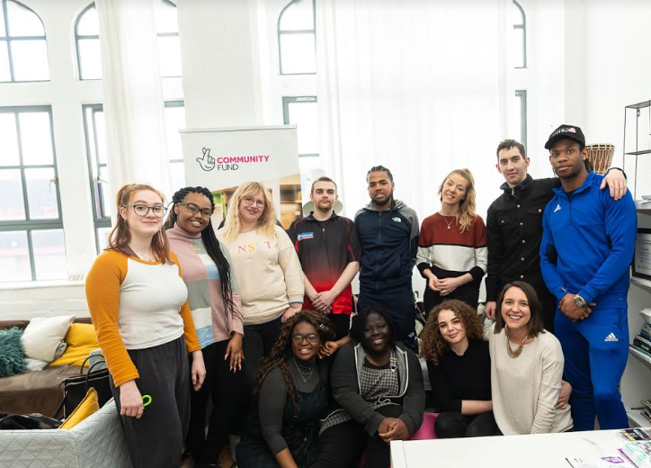
Created By Young People In the Lead
"The absence, of our voices, makes no sense; our voice is power, and we don't mean to
cause offence. Our voice is our
power, we are tomorrow's leaders, and this is our hour."
#ypildoneit

